Slide 1
The Case of Kosovo
Challenges of Teenagers in Their Career Decision
Sovran Berisha - KCDF
sovran.berisha@koscdf.org
Lumnie Mehmetaj
lumemeh@yahoo.com
29/10/2021

Slide 2
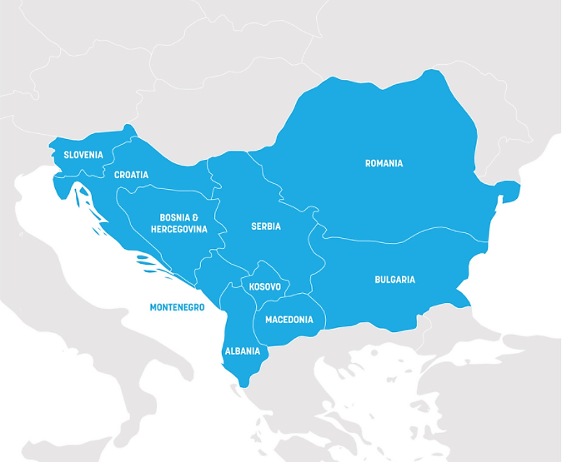
About Kosovo
Balkans, Southeastern Europe
1.8 million people
The youngest population in Europe, 1/4 under the age of 15
Around 40% are below 29 years
Unemployment rate: 25.8% (male 23.5 %, female 32.3%)
Youth unemployment rate: 48.9%
Inactive rate 61.7% (44% male, 79.2% % female)
Notes:
Kosovo has a population of 1.79 million (KAS, 2018 ), Kosovo has the youngest population and this puts pressure on both the education system and the labour market, but also has a very good chance to benefit by proper investment in its education system. According to the labour market barometer the unemployment rate is 25.8%. Unemployment is most pronounced among females with 32.3%, compared to males, 23.5%. The most significant unemployment rate is amongst youth with 48.9% and inactive labour force is quite high at 61.7%, with a particular focus on females at 79.2%, compared to males at 44%.

Slide 3
Career, Development, Support, System
There is a mismatch between education offer and labor market needs
Two-fold problem: quantity and quality of education offer
Career, Development, Support, System
Career education in schools
Role of the Employment Agency
Role of Municipal Youth Centers
Economic chambers and industry associations
Higher education institutions
Notes:
In Kosovo, as we mentioned earlier, unemployment rate among youth is enormous. However, the paradox is that many businesses are having a hard time finding skilled workforce for their business needs. Many of them list HR problems as the main impediments in optimizing their productivity. This talks to a two-fold problem:
Many profiles and concentrations offered by secondary and postsecondary education are irrelevant to the market needs. For many of these profiles, the market is already saturated with, and many youths remain unemployed.
For many of these profiles and concentrations, the curriculum content is inadequate to the labor market needs. In other words, schools are offering skills and knowledge that the labor market no longer needs

Slide 4
Purpose of the study
Understanding the current support teenagers receive
Career thinking
Interaction and access to the world of work
Maturity for the world of work
Sample size: 733 grade XI and XII students from 98 schools
Gender representation: 55% women, 45% men
Notes:
Therefore, through this study, we aim to provide evidence for MESTI, Municipal Education Directorates, and VET schools themselves about the importance of looking at how youth feels about their future, and taking mitigation action, accordingly. In Kosovo, there are in total 105 upper secondary schools (69 VET schools and 36 gymnasiums) and the survey was sent out to each of them. Responses were gathered from 733 students covering 98 out of the 105 municipalities.

Slide 5
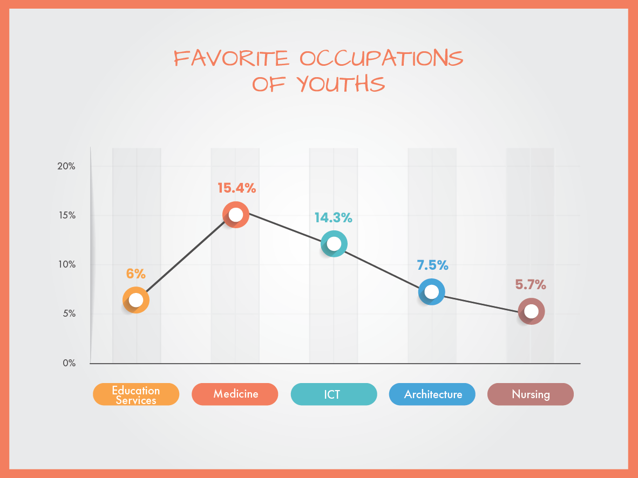
Main Findings –Favorite Occupations
Notes:
These findings are not a surprise to us, because in almost every study we conduct with youth, ICT and Medicine turn out to be among the most favorite occupations. We think that this is closely related to the opportunities in the labor market, which have also helped the image of the respective occupation fields.
For example, ICT is one of the industries mostly booming in the country. Many international businesses and corporations are offshoring their IT services to Kosovo (IT, call centers, digitalization of services, etc.) because of the more affordable workforce costs. However, a concerning finding is that choosing a career in Medicine-related occupations is a signal of brain-drain. Our country is facing a very large rate of migration. Many young Kosovars are leaving the country (mostly going to Germany, Austria, and Switzerland) in pursuit of better career opportunities. So, many of them choose Medicine because they know it is an easy way to arrange the migration as well as there is a lot of potential in the Western European countries. While we have a lot of youth, many of them favoring Medicine, we still face a shortage of medical staff within the country.

Slide 6
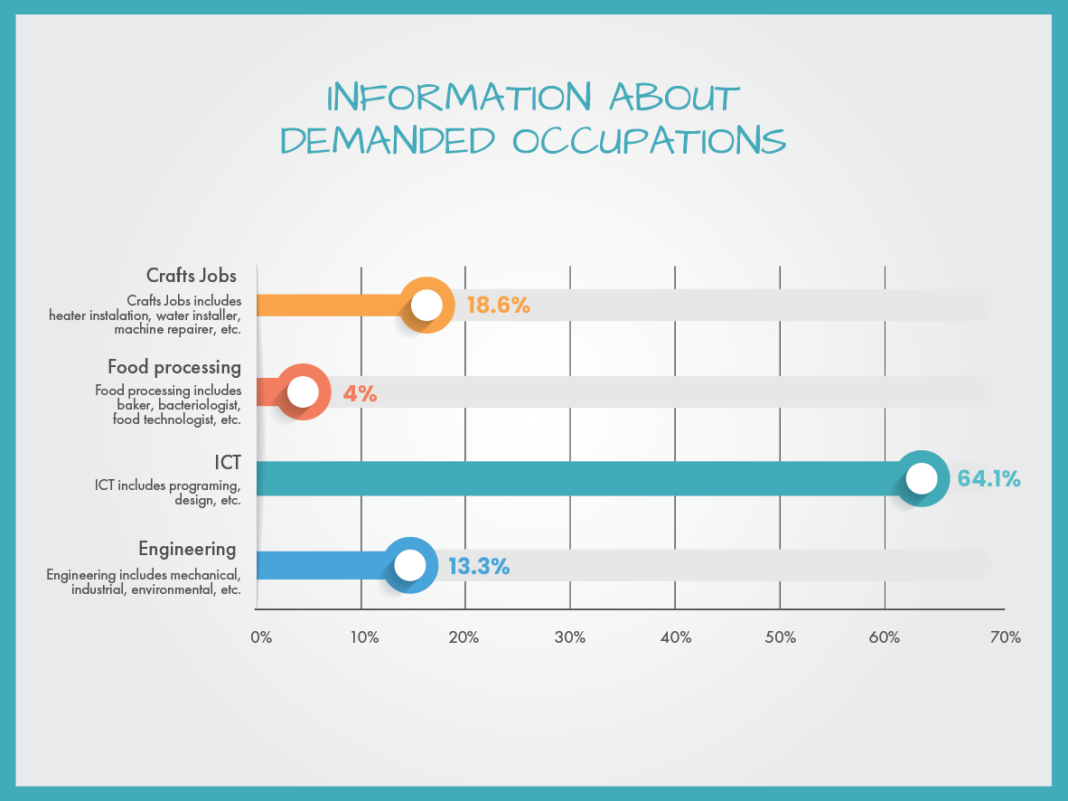
Main Findings –Most Demanded Occupations
Notes:
Based on studies conducted locally and based on the cooperation of KCDF with chambers and industry associations, we understand that Crafts Jobs, Food processing, ICT, and Engineering are jobs with most opportunities in the country. Therefore, we wanted to understand the extent to which our youth are aware and informed about such job opportunities.

Slide 7
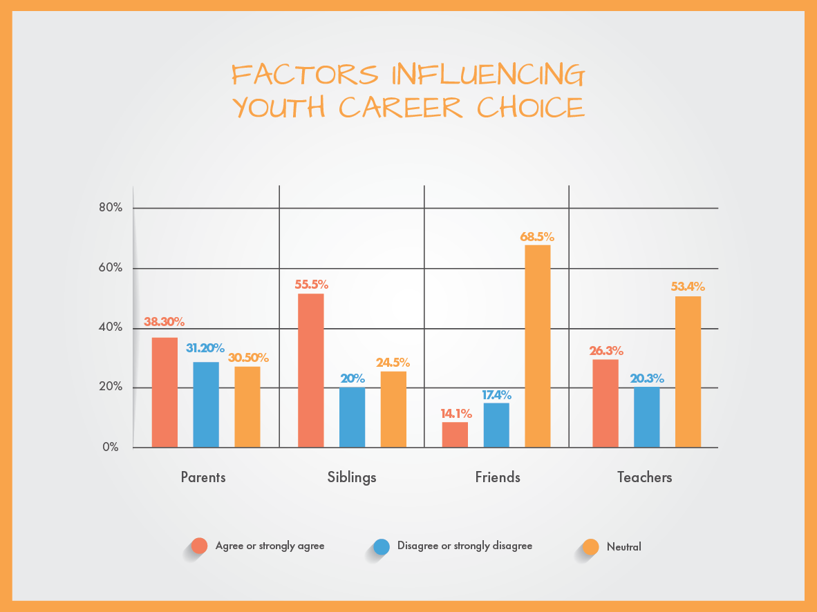
Main Findings –Influence on Career Decision
Notes:
We can see that family is by far the most important factor influencing youth career choice. For the policy-making institutions and other stakeholders this is an important information. Unfortunately, family is not very much engaged in obtaining information and understanding the practices for guiding youth to the right career path, gathering information about the opportunities in the labor market, etc. More needs to be done in this regard to provide more accurate and objective career support for youth.

Slide 8
Main Findings –Future Outlook of Youth
69% of the youth planning to migrate, report to do so regardless of the opportunities in Kosovo.
Notes:
The large number of youth who plan to migrate is worrisome for the local economy. Many of them, as indicated in the slide, declare that they would migrate even if they had their preferred job in the country. The indicates a high level of uncertainty among youth, about the sustainability of their jobs, employment opportunities in the future, etc.

Slide 9
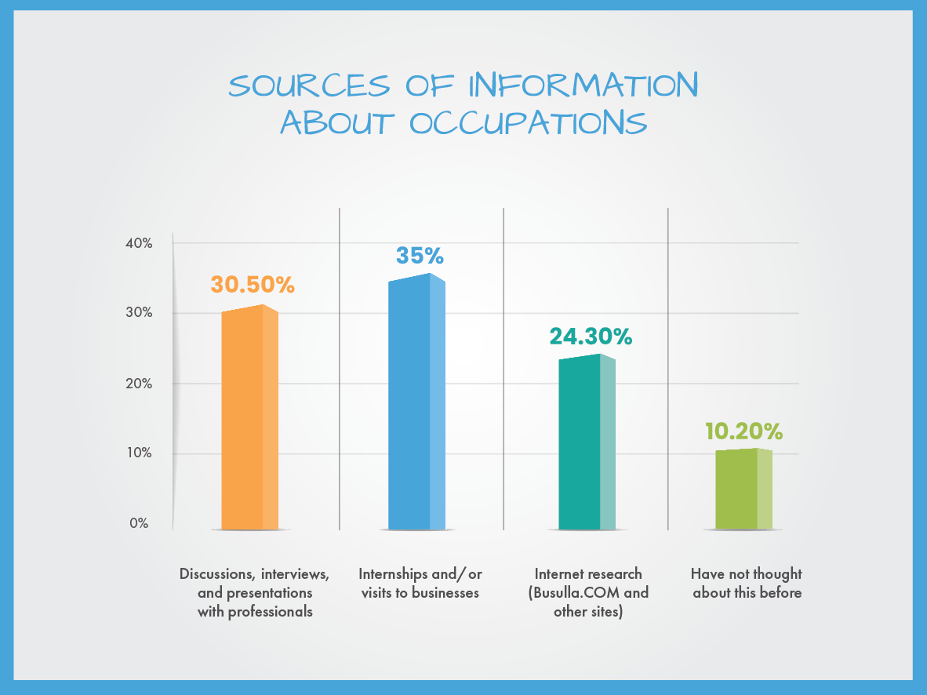
Main Findings –Sources of Career Information

Slide 10
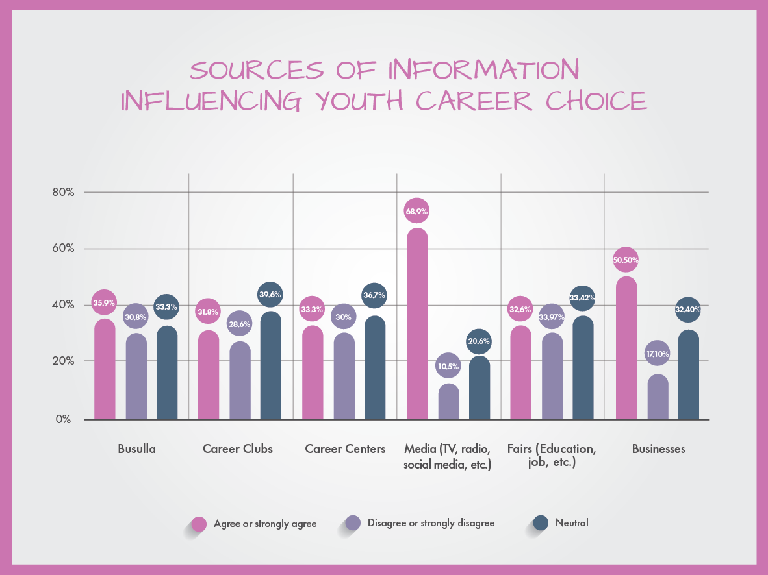
Main Findings –Support for Career Decision
Notes:
Career Clubs are extra-curricular activities taking place in gymnasiums. They are managed by a group of 15 students from grades X, XI, and XII and they are monitored by the Life and Work teacher. The main objectives of these clubs are to develop soft-skills among students by organizing events with guest speakers, trainers, and experts on different fields as well as by organizing information sessions related to career education and guidance.
School-Based Career Centers are VET school offices which hire 3 people, with the main aim being: 1. to promote VET school profiles to prospective students, 2. to provide career guidance services to existing school students, 3. to partner with local businesses.

Slide 11
Main Findings – Impact of COVID-19
Around 89.5% of the respondents consider that COVID-19 has put more importance in skills related to self-management, time-management, and digital skills, while only 10.5% do not agree that COVID-19 has had any impact in the way work will be done in the future.

Slide 12
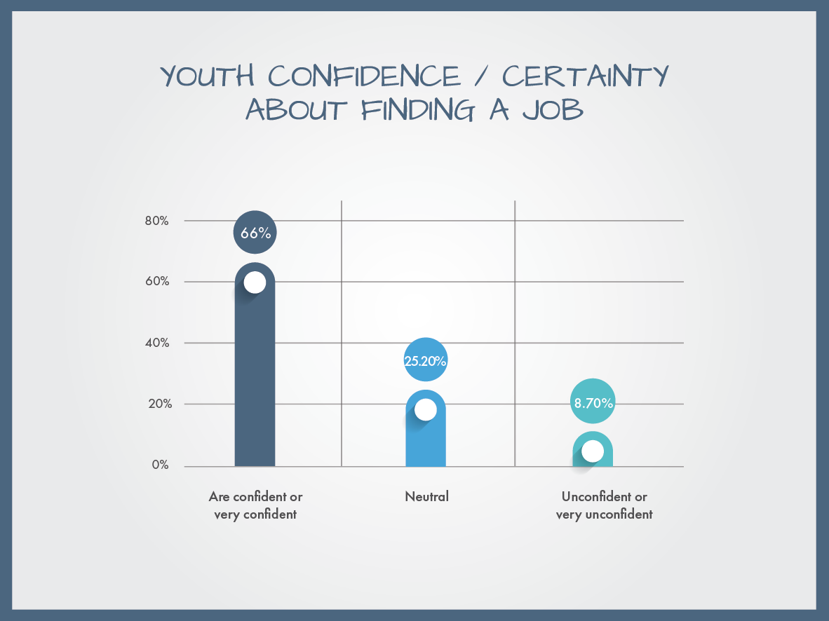
Main Findings – Certainty about Finding a Job
Yet 94.1% respond positively about their need to obtain new skills. Most frequently listed skills were ICT-related skills (coding and design), communication, time-management, and organization skills.

Slide 13
THANK YOU FOR YOUR ATTENTION!
Comments & Questions
Sovran Berisha
sovran.berisha@koscdf.org
+383-44-375-963
Lumnie Mehmetaj
lumemeh@yahoo.com
+383-44-126-035

